Slide 1
Process Scheduling Simulator
Team : Phoenix Presented by: Rama Gupta
Group No. : 7 Saurabh Sathaye
Shubham Goyal

Slide 2
INTRODUCTION :
Multiprogramming is one of the most important aspects of operating systems.
It refers to a set of policies and mechanisms to control the order of work to be performed by a computer system.
The basic CPU scheduling algorithms are:
First Come First Serve (FCFS)
Shortest Job First (SJF)
Round Robin (RR)

Slide 3
First come first serve:
Advantages:
Simple
Easy to implement
Disadvantages:
Non preemptive, short processes at the back of queue have to wait too long

Slide 4
Shortest job First
Advantages:
Minimizes average wait time.
Disadvantages:
Non Preemptive
Requires future knowledge of burst time.
Can lead to starvation as long jobs may never be scheduled.

Slide 5
Round Robin:
Advantages:
Jobs get fair share of CPU (No starvation)
CPU utilization is almost 100% as the CPU never gets idle.
Disadvantages:
If the time quantum is too short, then too much process switching will take place and design will become slow.
If time quantum too large then it may act as FCFS.

Slide 6
Improved Round Robin
The performance of RR scheduling is sensitive to time quantum selection.
Each value of time quantum will lead to a specific performance and will affect the algorithm's efficiency by affecting the processes waiting time, turnaround time, response time and number of context switches.
Time quantum is selected dynamically, by taking the average of the available burst time of processes in the ready queue.

Slide 7
Multilevel queue
A multilevel queue scheduling algorithm partitions the ready queue in several separate queues.
In a multilevel queue scheduling processes are permanently assigned to one queues.
No process in the lower priority queue runs unless the higher priority processes complete the job.
This may lead to starvation as the priority of the processes is never being changed.

Slide 8
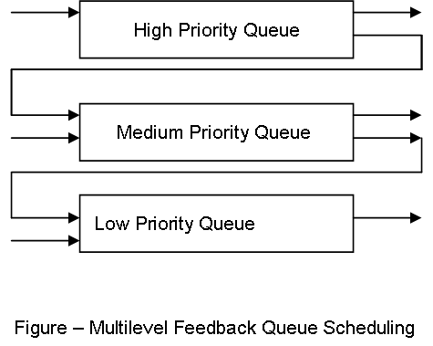
Multilevel feedback queue
Multi Level feed queue allows a process to move between queues.
There are typically 3 type of queues:
High priority queue
Medium priority queue
Low priority queue

Slide 9
Multilevel Feedback Queue
The Scheduler starts picking up the process from the head of highest priority queue.
The jobs in each queue are processed on first come first serve basis.
After a certain time quantum the priority level of the jobs are changed.
Jobs with higher priority are executed first.

Slide 10
MLFQ with Shortest job first
The Scheduler starts picking up the process from the head of highest priority queue.
The jobs in a queue are ordered according to the SJF algorithm.
If Queue becomes empty then only the scheduler takes up a process from a lower priority queue.
Meanwhile, if a process comes into any of the higher level queues, it will preempt a process in the lower level queue.
If a process uses too much CPU time, it will be moved to a lower priority queue

Slide 11
Comparing existing algorithms with MLFQ using SJF

Slide 12
Scheduler performance evaluation criterias :
Turn-around time
Response time
waiting time
Average waiting time
Average response time
Average turnaround time

Slide 13
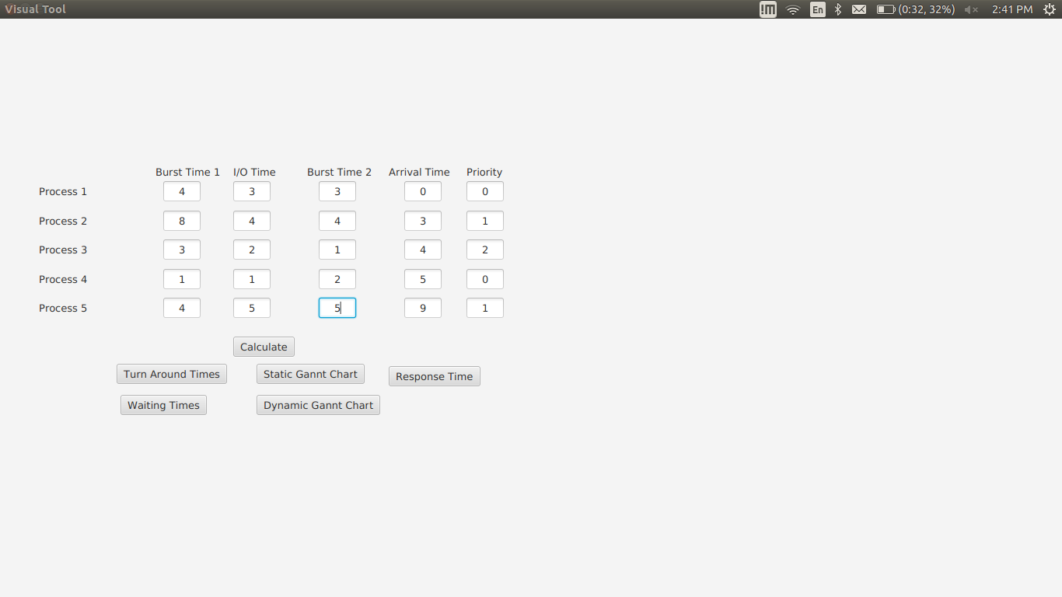
Simulation Tool : Overview

Slide 14
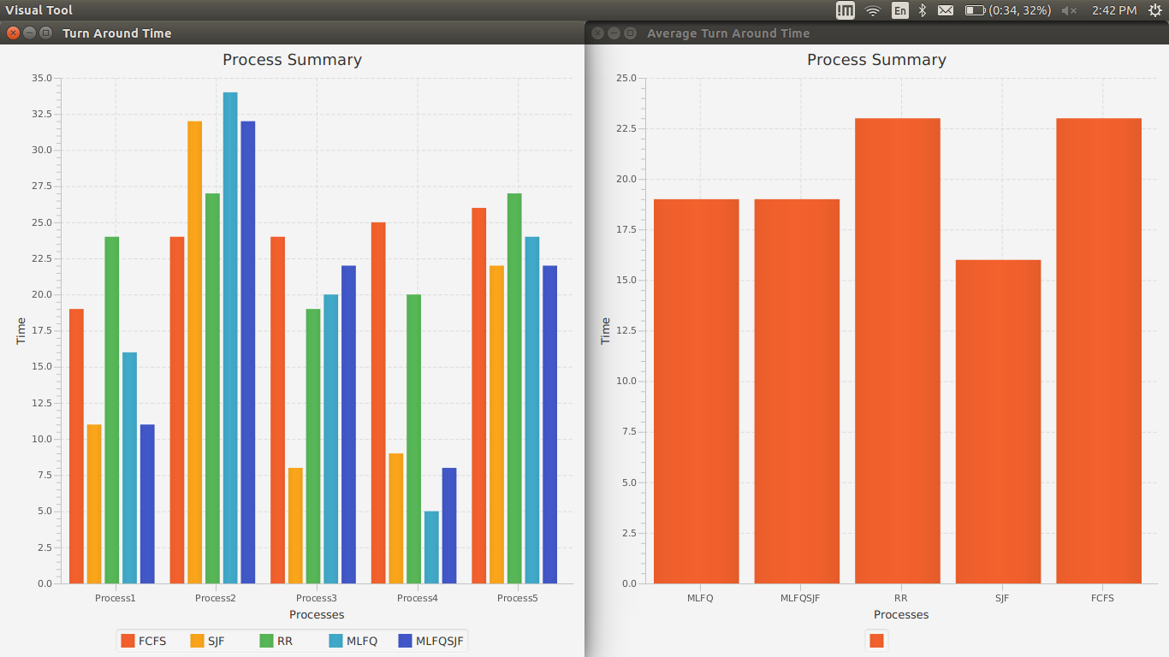
Analysis : Turn Around Time
Notes:
TODO: CHANGE IT (Its still showing MLFQFCFS)

Slide 15
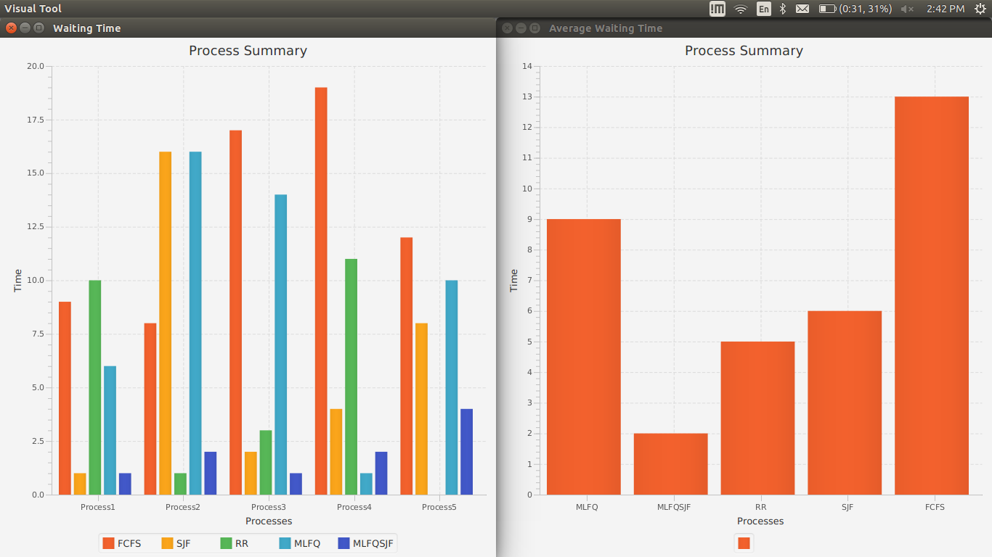
Analysis : Waiting time
Notes:
TODO: CHANGE IT (Its still showing MLFQFCFS)

Slide 16
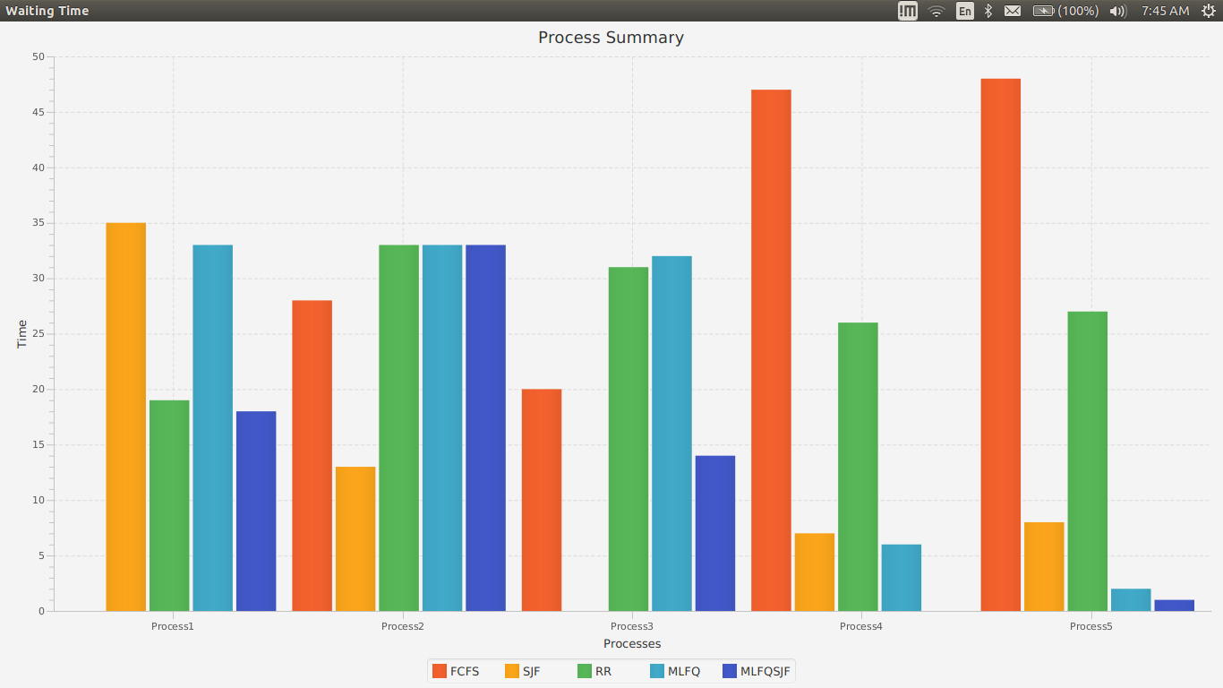

Slide 17
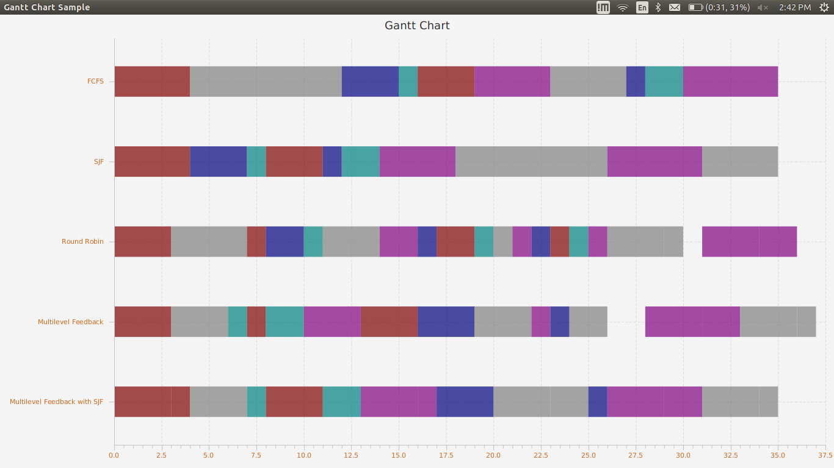

Slide 18
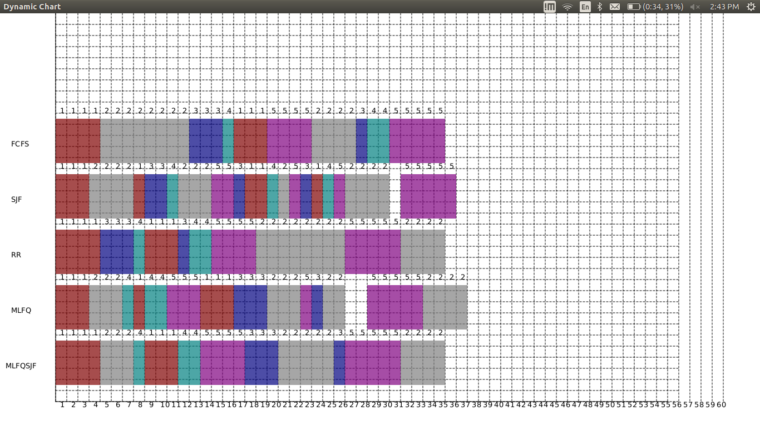

Slide 19
DEMO

Slide 20
Summary
Sr no. | Parameter | FCFS | SJF | RR | MLFQ | MLFQ with SJF
1 | Preemption | Non preemptive | Non preemptive | preemptive | preemptive | preemptive
2 | Allocation | Allocates the CPU in the order of arrival | Allocates the CPU in the order of burst time | CPU is allocated in the order of which process arrives but for a fixed quantum of time | Cpu is allocated to the job in higher priority queue. With FCFS in each queue. | Cpu is allocated to the job in higher priority queue. With SJF in each queue.
3 | Waiting time | Avg waiting time is large. | Avg waiting time is small | Avg waiting time is higher than FCFS and SJF | Depends on priority and Quantum | Depends on priority and Quantum. Better than MLFQ with FCFS

Slide 21
Further Research
Number of research work have been performed on CPU scheduling problems on different applications using Fuzzy logic.
Fuzzy Logic is an extension of Boolean logic, dealing with concept of partial truth that denotes the extent to which a proposition is true.
A fuzzy inference system tries to derive answers from a knowledge base using a fuzzy inference engine.
Fuzzy Inference System consists of an input state, an output state and a processing stage.

Slide 22
Input stage maps input:
Deadline
Priority.
Processing Stage:
Collection of rules in the form of IF-THEN statements.
Decisions are based on testing all the rules in Fuzzy Inference Subsystem.
eg: Mamdani FIS, Sugeno FIS.

Slide 23
Thank you

